Slide 1
Solid principal in php

Slide 2
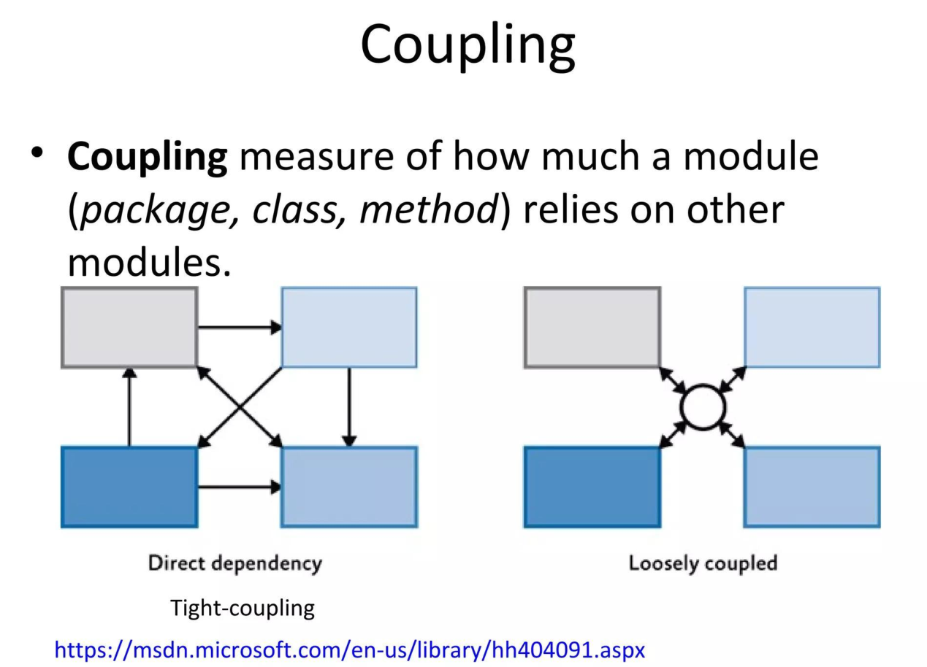

Slide 3
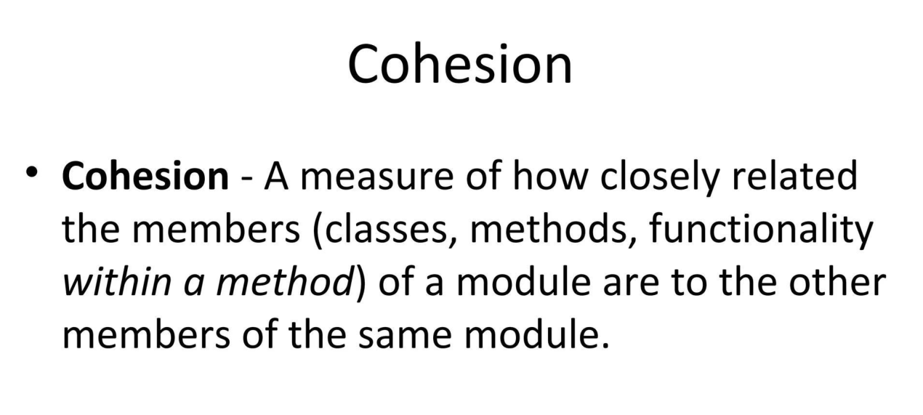

Slide 4
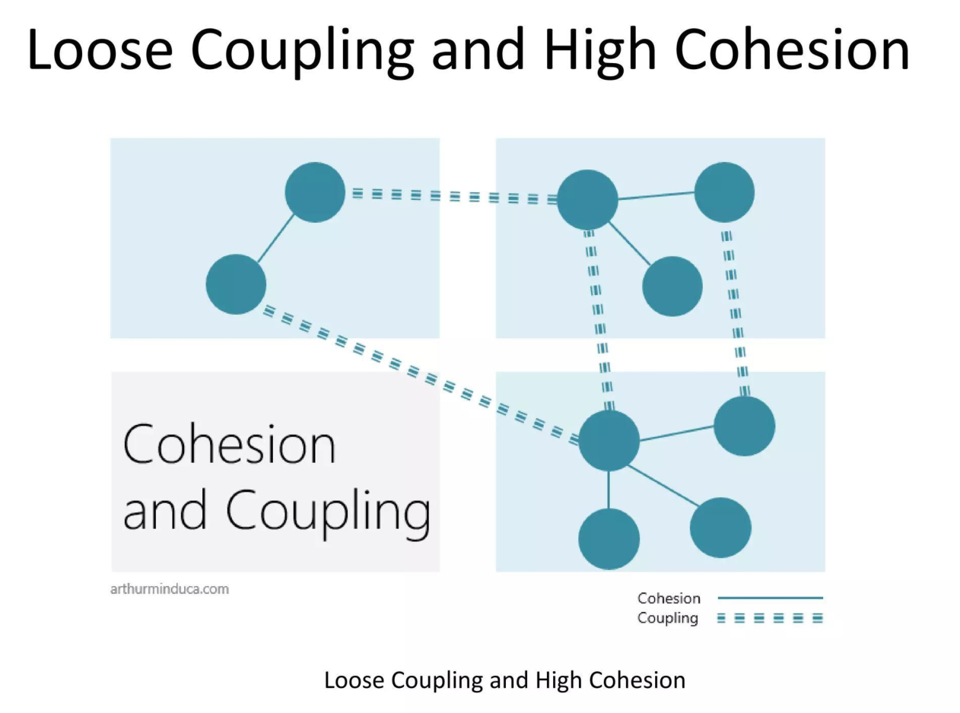

Slide 5
SOLID principles are a set of five design guidelines
—Single Responsibility,
Open/Closed,
Liskov Substitution,
Interface Segregation, and
Dependency Inversion—
that help PHP developers create code that is easier to maintain, test, and scale.

Slide 6
1. Single Responsibility Principle (SRP)
A class should have only one reason to change.
This means a class should perform one specific task and nothing else.
If a class handles data validation, database storage, and email notifications all at once, it’s doing too much.

Slide 7
Bad code
class User {
public function create(array $data) {
// 1. Save user to database
$db = new Database();
$db->query("INSERT INTO users ...");
// 2. Send welcome email (Violates SRP!)
mail($data['email'], "Welcome!", "Thanks for signing up.");
}
}

Slide 8
Correct Example
We split the responsibilities into two separate classes: one for database persistence and one for notifications.
class UserRepository {
public function save(array $data) {
// Only handles database logic
$db = new Database();
$db->query("INSERT INTO users ...");
}
}
class EmailService {
public function sendWelcomeEmail($email) {
// Only handles email logic
mail($email, "Welcome!", "Thanks for signing up.");
}
}
// Usage
class UserController {
public function register(array $data, UserRepository $repo, EmailService $emailService) {
$repo->save($data);
$emailService->sendWelcomeEmail($data['email']);
}
}

Slide 9
Open/Closed Principle (OCP)
"Software entities should be open for extension, but closed for modification."
You should be able to add new functionality without changing the existing code.
We achieve this in PHP using Interfaces.

Slide 10
Bad Example
If we want to add a new payment method (like Stripe), we have to modify the existing PaymentManager class, which risks breaking PayPal.
class PaymentManager {
public function processPayment($type) {
if ($type === 'paypal') {
// PayPal logic
} elseif ($type === 'stripe') { // Modifying existing class!
// Stripe logic
}
}
}

Slide 11
Good Example
Define a PaymentMethod interface. Now, you can add as many payment methods as you want by creating new classes, without ever touching the PaymentProcessor.
interface PaymentMethod {
public function pay($amount);
}
class PaypalPayment implements PaymentMethod {
public function pay($amount) { /* PayPal logic */ }
}
class StripePayment implements PaymentMethod {
public function pay($amount) { /* Stripe logic */ }
}
// This class is CLOSED to modification, but OPEN to extension
class PaymentProcessor {
public function process(PaymentMethod $method, $amount) {
$method->pay($amount);
}
}

Slide 12
Liskov Substitution Principle (LSP)
"Objects of a superclass should be replaceable with objects of its subclasses without breaking the application.“
A child class must be able to do everything the parent class promises. It should not break the expectations set by the parent.

Slide 13
Bad Example
A Penguin is a Bird, but it cannot fly. Forcing it to implement fly() breaks the application's expectations.
class Bird {
public function fly() { return "Flying high!"; }
}
class Penguin extends Bird {
public function fly() {
throw new Exception("I can't fly!"); // Violates LSP!
}
}

Slide 14
Good Example
Break the behaviors down so subclasses don't inherit methods they can't support.
class Bird {
public function eat() { return "Eating..."; }
}
interface FlyingBird {
public function fly();
}
class Eagle extends Bird implements FlyingBird {
public function fly() { return "Flying high!"; }
}
class Penguin extends Bird {
// Penguins just eat, they don't implement FlyingBird
}

Slide 15
Interface Segregation Principle (ISP)
"A client should never be forced to implement an interface it doesn't use.“
It is better to have many small, specific interfaces than one massive "fat" interface.

Slide 16
Bad Example
An Ostrich is forced to implement a fly method it doesn't need just because it implements Animal.
interface Animal {
public function walk();
public function fly();
}
class Ostrich implements Animal {
public function walk() { /* Walking logic */ }
public function fly() { return null; } // Useless implementation!
}

Slide 17
Good Example
Split the interface into smaller, focused interfaces.
PHP
interface Walkable {
public function walk();
}
interface Flyable {
public function fly();
}
class Ostrich implements Walkable {
public function walk() { /* Walking logic */ }
}
class Parrot implements Walkable, Flyable {
public function walk() { ... }
public function fly() { ... }
}

Slide 18
Dependency Inversion Principle (DIP)
"High-level modules should not depend on low-level modules. Both should depend on abstractions."
Don't hardcode specific dependencies inside your classes. Instead, inject dependencies via interfaces (abstractions).

Slide 19
Bad Example
The high-level PasswordReminder is tightly coupled to the low-level MySQLConnection.
If you want to switch to MongoDB, you have to rewrite this class.
class MySQLConnection {
public function connect() { return "Database connection"; }
}
class PasswordReminder {
private $dbConnection;
public function __construct() {
// Hardcoded dependency!
$this->dbConnection = new MySQLConnection();
}
}

Slide 20
Good Example
We introduce a DbConnectionInterface. PasswordReminder doesn't care what database it is, as long as it adheres to the interface.
interface DbConnectionInterface {
public function connect();
}
class MySQLConnection implements DbConnectionInterface {
public function connect() { return "MySQL Connection"; }
}
class MongoConnection implements DbConnectionInterface {
public function connect() { return "MongoDB Connection"; }
}
class PasswordReminder {
private $dbConnection;
// Inject the interface, not the concrete class
public function __construct(DbConnectionInterface $dbConnection) {
$this->dbConnection = $dbConnection;
}
}
// Usage
$mysql = new MySQLConnection();
$reminder = new PasswordReminder($mysql);

